Slide 1
Syntax - Introduction
Syntax
Week 5: Lecture 1
1 / 14

Slide 2

What is Syntax?
Refers to the way words are arranged together, and the relationship between then.
Language Models: Importance of modeling word order
POS categories: An equivalence class for words
More complex notions: constituency, grammatical relations, subcategorization etc.
Syntax
2 / 14

Slide 3
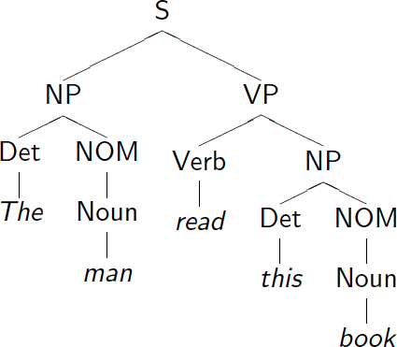
Syntax Tree: Example
Syntax
Week 5: Lecture 1
3 / 14

Slide 4
Defining the notions: Constituency
Constituent
A group of words acts as a single unit - phrases, clauses etc.
Part of Speech - “Substitution Test"
The {sad, intelligent, green, fat, ...} one is in the corner.
Constituency: Noun Phrase
Kermit the frog they
December twenty-sixth
the reason he is running for president
Syntax
Week 5: Lecture 1
4 / 14

Slide 5
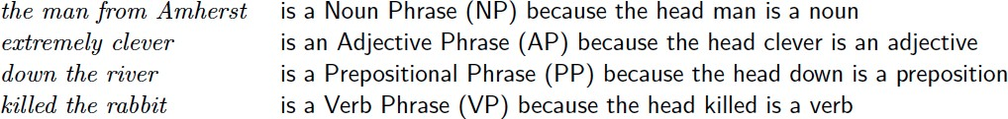
Constituent Phrases
Usually named based on the word that heads the constituent:
Words can also act as phrases
Joe grew potatoes
Joe and potatoes are both nouns and noun phrases
Compare with: The man from Amherst grew beautiful russet potatoes. Joe appears in a place that a larger noun phrase could have been.
Syntax
Week 5: Lecture 1
5 / 14

Slide 6
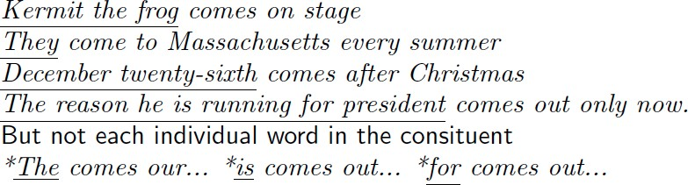
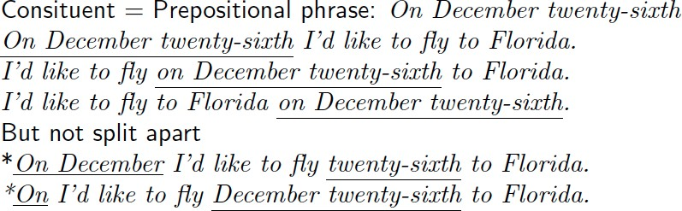
Evidence that constituency exists
They appear in similar environments
Can be placed in a number of different locations
Syntax
Week 5: Lecture 1
6 / 14

Slide 7
Modeling Constituency: what tool do we need?
Syntax
Week 5: Lecture 1
7 / 14

Slide 8
Modeling Constituency
Context-free grammar
The most common way of modeling constituency
Consists of production Rules
These rules express the ways in which the symbols of the language can be grouped and ordered together
Example
Noun phrase can be composed of either a ProperNoun or a determiner (Det) followed by a Nominal; a Nominal can be more than one nouns
NP → Det Nominal
NP → ProperNoun
Nominal → Noun | Noun Nominal
Syntax
Week 5: Lecture 1
8 / 14

Slide 9
CFG for Languages
CFG: G = (T, N, S, R)
T: set of terminals
N: set of non-terminals
For NLP, we distinguish out a set P ⊂ N of pre-terminals, which always rewrite as terminals
S : start symbol
R: Rules/productions of the form X → γ, X ∈ N and γ ∈ (T ∪ N)∗
Terminals and pre-terminals
Terminals mainly correspond to words in the language while pre-terminals mainly correspond to POS categories
Syntax
Week 5: Lecture 1
9 / 14

Slide 10
CFG for Languages
Example
NP → Det Nominal
NP → ProperNoun
Nominal → Noun | Noun Nominal
Now, these can be combined with other rules, that express facts about a lexicon.
Det → a
Det → the
Noun → flight
Can you identify the terminal, non-terminals and preterminals?
Syntax
Week 5: Lecture 1
10 / 14

Slide 11
CFG as a generator
NP → Det Nominal
NP → ProperNoun
Nominal → Noun | Noun Nominal
Det → a
Det → the
Noun → flight Generating ‘a light’:
NP→ Det Nominal
→ Det Noun → a Noun → a flight
Thus a CFG can be used to randomly generate a series of strings
This sequence of rule expansions is called a derivation of the string of words, usually represented as a tree
Syntax
Week 5: Lecture 1
11 / 14

Slide 12
CFGs and Grammaticality
A CFG defines a formal language = set of all sentences (string of words) that can be derived by the grammar
Sentences in this set are said to be grammatical
Sentences outside this set are said to be ungrammatical
Syntax
Week 5: Lecture 1
12 / 14

Slide 13
CFGs and Recursion
Recursive Definition
PP → Prep NP
NP → Noun PP
Example Sentence
[_{S}The mailman ate his [_{NP} lunch [_{PP} with his friend [_{PP} from the cleaning staff
[_{PP} of the building [_{PP} at the intersection [_{PP} on the north end [_{PP} of town]]]]]]].
Syntax
Week 5: Lecture 1
13 / 14

Slide 14
What does Context stand for in CFG?
The notion of context has nothing to do with the ordinary meaning of word context in language
All it really means is that the non-terminal on the left-hand side of a rule is out there all by itself (free of context)
A → BC
I can rewrite A as B followed by C regardless of the context in which A is found
Or when I see a B followed by a C, I can infer an A regardless of the surrounding context
Syntax
Week 5: Lecture 1
14 / 14

Slide 15
Syntax -Parsing I
Syntax
Week 5: Lecture 2
1 / 60

Slide 16
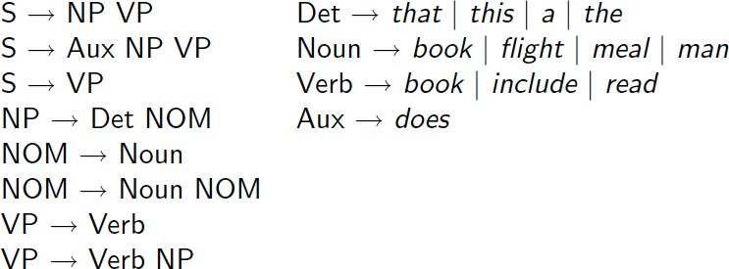
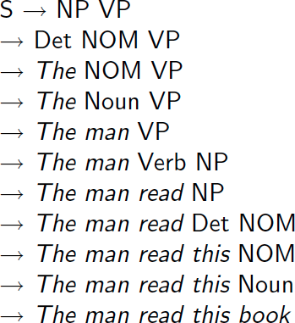
Grammar Rewrite Rules
Syntax
Week 5: Lecture 2
2 / 60

Slide 17
Parse Tree
Syntax
Week 5: Lecture 2
3 / 60

Slide 18
Parse Tree
Syntax
Week 5: Lecture 2
3 / 60

Slide 19
What is Parsing?
The process of taking a string and a grammar and returning all possible parse trees for that string
That is, find all trees, whose root is the start symbol S, which cover exactly the words in the input
What are the constraints? “book that flight”
There must be three leaves, book, that and flight
The tree must have one root, the start symbol S
Give rise to two search strategies: top-down (goal-oriented) and
bottom-up (data-directed)
Syntax
Week 5: Lecture 2
4 / 60

Slide 20
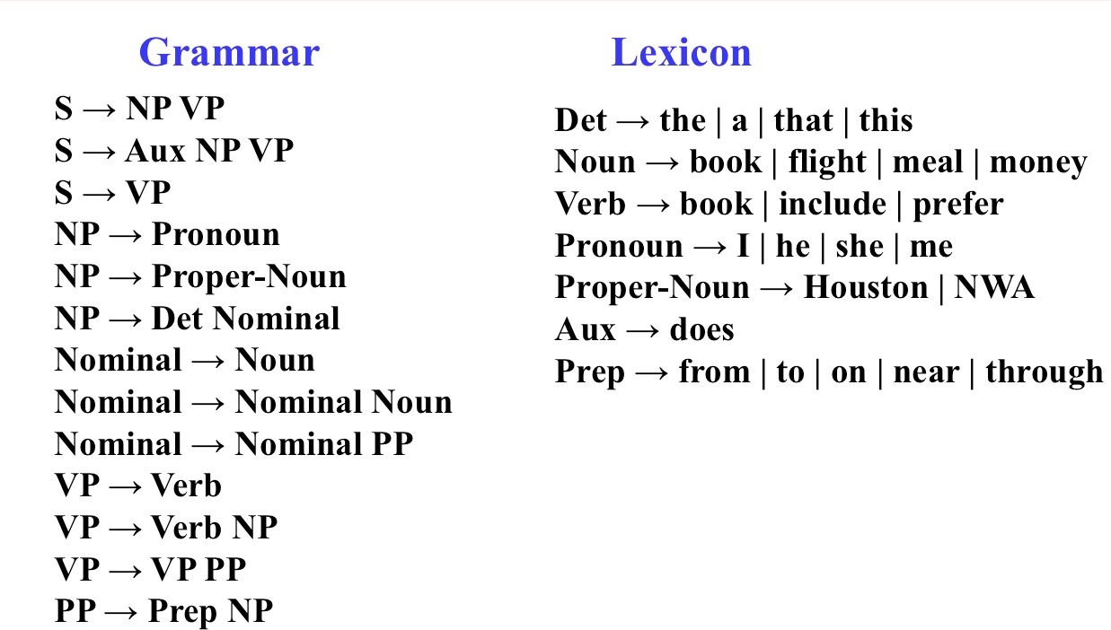
Parsing
Syntax
Week 5: Lecture 2
5 / 60

Slide 21
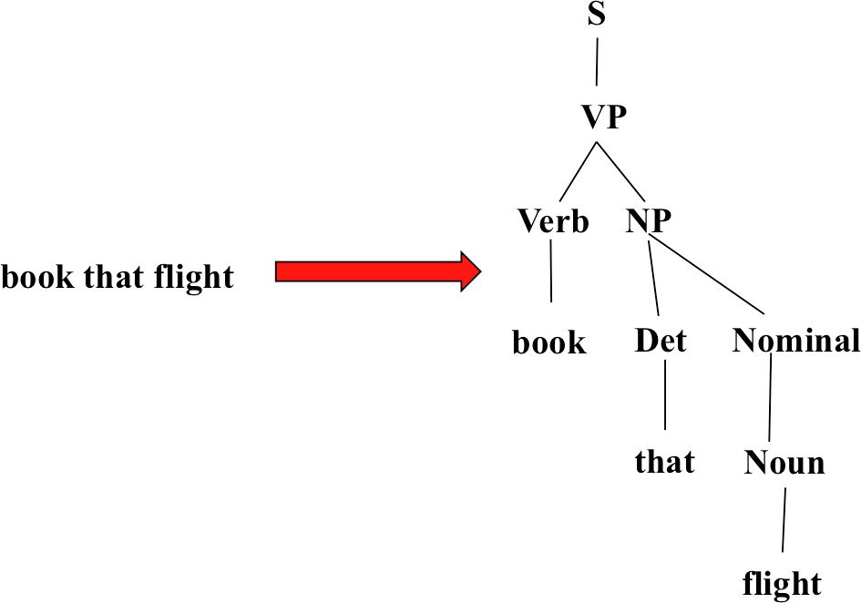
Parsing
Syntax
Week 5: Lecture 2
6 / 60

Slide 22
Top-Down Parsing
Searches for a parse tree by trying to build upon the root node S down to the leaves
Start by assuming that the input can be derived by the designated start symbol S
Find all trees that can start with S, by looking at the grammar rules with S
on the left-hand side
Trees are grown downward until they eventually reach the POS categories at the bottom
Trees whose leaves fail to match the words in the input can be rejected
Syntax
Week 5: Lecture 2
7 / 60

Slide 23
Top-Down Parsing
Syntax
Week 5: Lecture 2
8 / 60

Slide 24
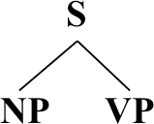
Top-Down Parsing
Syntax
Week 5: Lecture 2
9 / 60

Slide 25
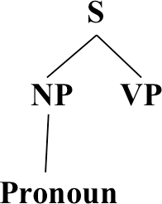
Top-Down Parsing
Syntax
Week 5: Lecture 2
10 / 60

Slide 26
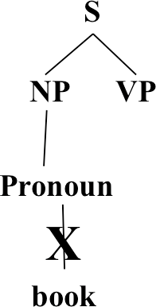
Top-Down Parsing
Syntax
Week 5: Lecture 2
11 / 60

Slide 27
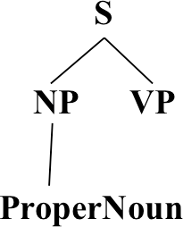
Top-Down Parsing
Syntax
Week 5: Lecture 2
12 / 60

Slide 28
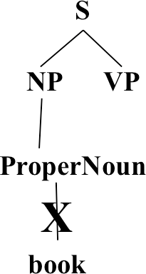
Top-Down Parsing
Syntax
Week 5: Lecture 2
13 / 60

Slide 29
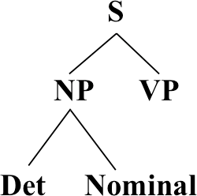
Top-Down Parsing
Syntax
Week 5: Lecture 2
14 / 60

Slide 30
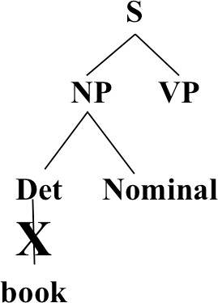
Top-Down Parsing
Syntax
Week 5: Lecture 2
15 / 60

Slide 31
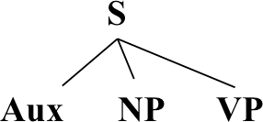
Top-Down Parsing
Syntax
Week 5: Lecture 2
16 / 60

Slide 32
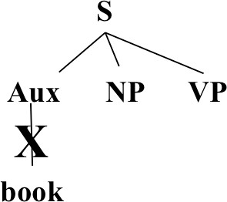
Top-Down Parsing
Syntax
Week 5: Lecture 2
17 / 60

Slide 33

Top-Down Parsing
Syntax
Week 5: Lecture 2
18 / 60

Slide 34

Top-Down Parsing
Syntax
Week 5: Lecture 2
19 / 60

Slide 35

Top-Down Parsing
Syntax
Week 5: Lecture 2
20 / 60

Slide 36
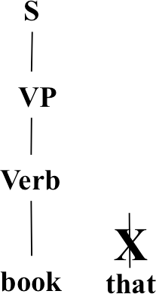
Top-Down Parsing
Syntax
Week 5: Lecture 2
21 / 60

Slide 37
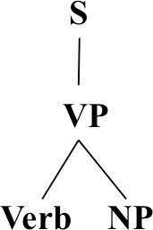
Top-Down Parsing
Syntax
Week 5: Lecture 2
22 / 60

Slide 38
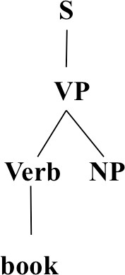
Top-Down Parsing
Syntax
Week 5: Lecture 2
23 / 60

Slide 39
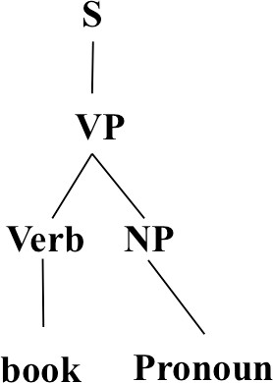
Top-Down Parsing
Syntax
Week 5: Lecture 2
24 / 60

Slide 40
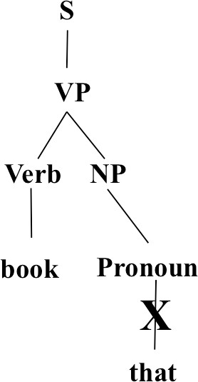
Top-Down Parsing
Syntax
Week 5: Lecture 2
25 / 60

Slide 41
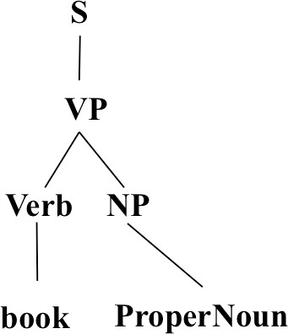
Top-Down Parsing
Pawan Goyal (IIT Kharagpur)
Syntax
Week 5: Lecture 2
26 / 60

Slide 42
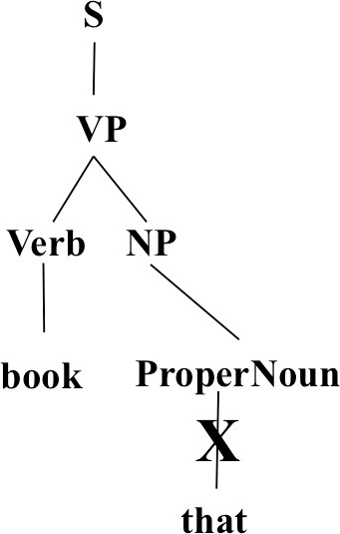
Top-Down Parsing
Syntax
Week 5: Lecture 2
27 / 60

Slide 43
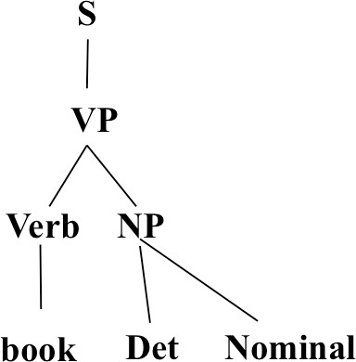
Top-Down Parsing
Syntax
Week 5: Lecture 2
28 / 60

Slide 44
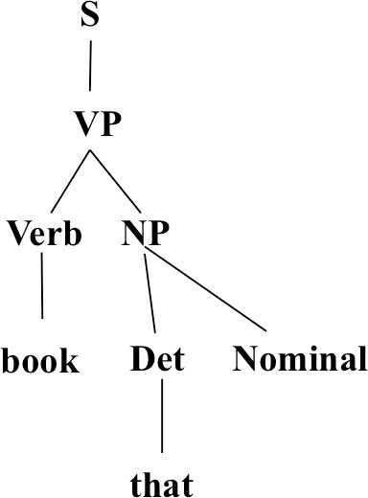
Top-Down Parsing
Syntax
Week 5: Lecture 2
29 / 60

Slide 45
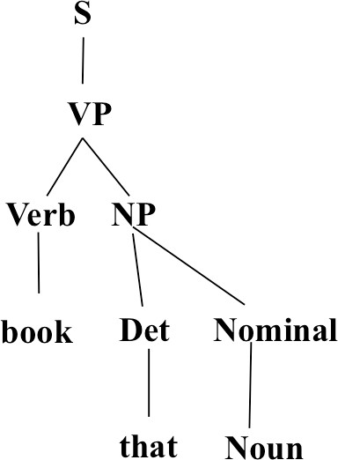
Top-Down Parsing
Syntax
Week 5: Lecture 2
30 / 60

Slide 46
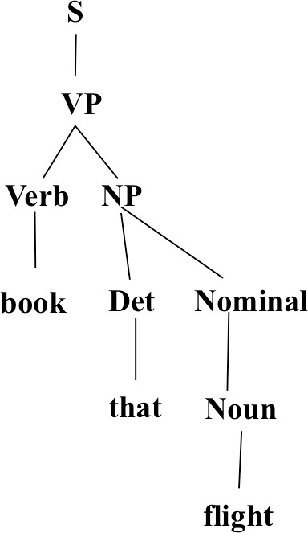
Top-Down Parsing
Syntax
Week 5: Lecture 2
31 / 60

Slide 47
Bottom-Up Parsing
The parser starts with the words of the input, and tries to build trees from the words up, by applying rules from the grammar one at a time
Parser looks for the places in the parse-in-progress where the right-hand-side of some rule might fit.
Syntax
Week 5: Lecture 2
32 / 60

Slide 48
Bottom-Up Parsing
Syntax
Week 5: Lecture 2
33 / 60

Slide 49
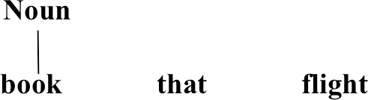
Bottom-Up Parsing
Syntax
Week 5: Lecture 2
34 / 60

Slide 50
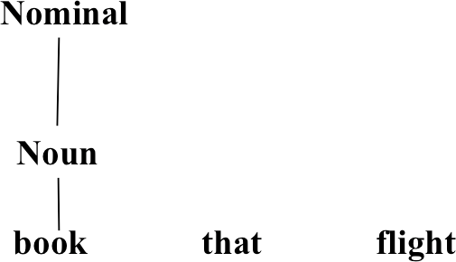
Bottom-Up Parsing
Syntax
Week 5: Lecture 2
35 / 60

Slide 51
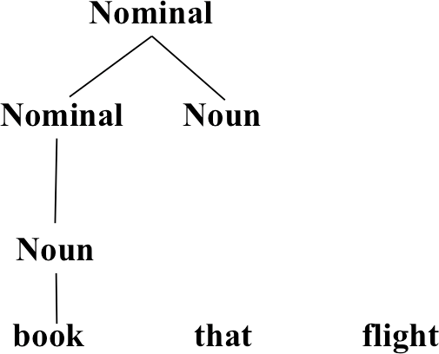
Bottom-Up Parsing
Syntax
Week 5: Lecture 2
36 / 60

Slide 52
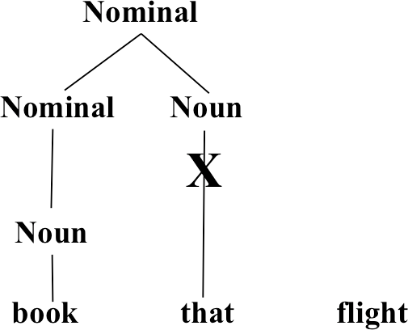
Bottom-Up Parsing
Syntax
Week 5: Lecture 2
37 / 60

Slide 53
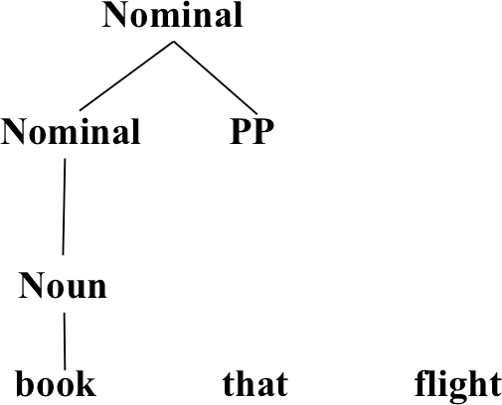
Bottom-Up Parsing
Syntax
Week 5: Lecture 2
38 / 60

Slide 54
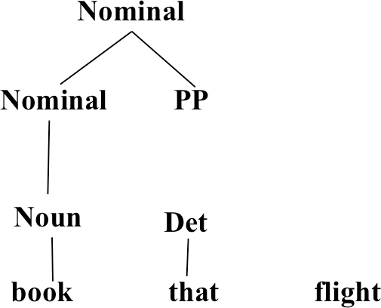
Bottom-Up Parsing
Syntax
39 / 60

Slide 55
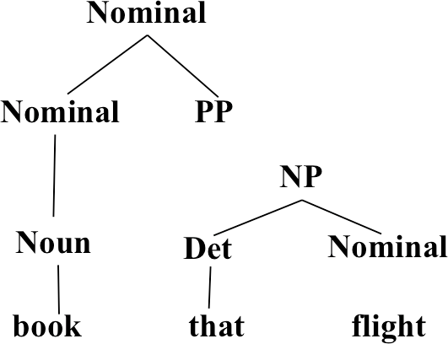
Bottom-Up Parsing
Syntax
Week 5: Lecture 2
40 / 60

Slide 56
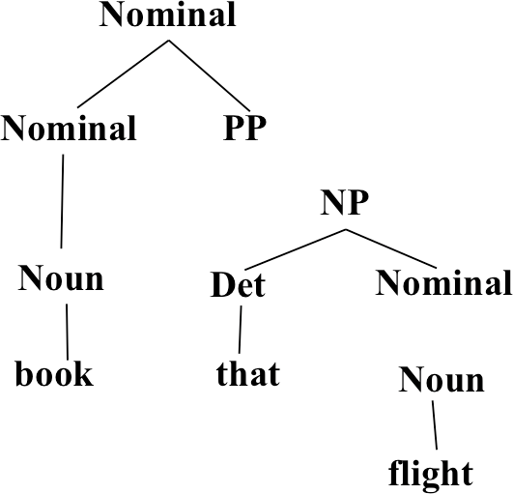
Bottom-Up Parsing
Syntax
Week 5: Lecture 2
41 / 60

Slide 57

Bottom-Up Parsing
Syntax
Week 5: Lecture 2
42 / 60

Slide 58
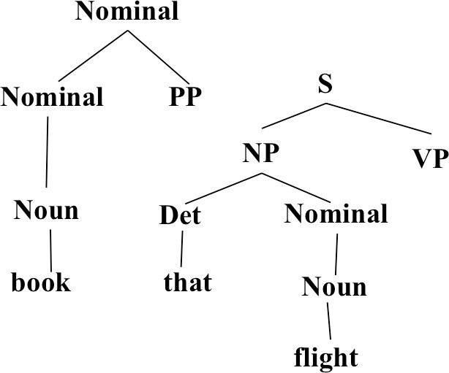
Bottom-Up Parsing
Syntax
Week 5: Lecture 2
43 / 60

Slide 59
Bottom-Up Parsing
Syntax
Week 5: Lecture 2
44 / 60

Slide 60
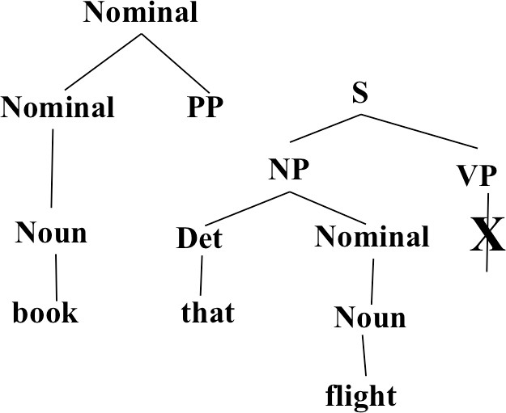
Bottom-Up Parsing
Syntax
Week 5: Lecture 2
45 / 60

Slide 61
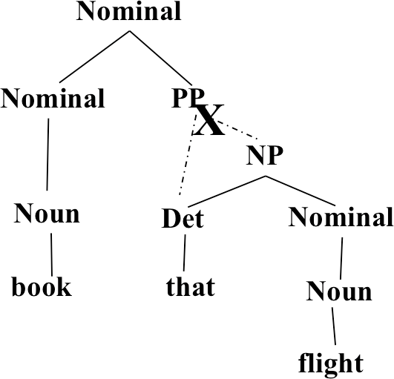
Bottom-Up Parsing
Pawan Goyal (IIT Kharagpur)
Syntax
Week 5: Lecture 2
46 / 60

Slide 62
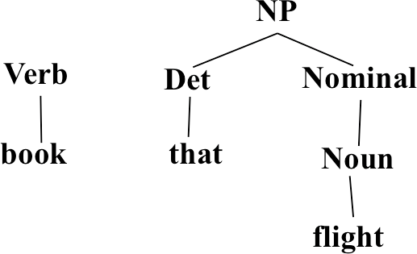
Bottom-Up Parsing
Syntax
Week 5: Lecture 2
47 / 60

Slide 63
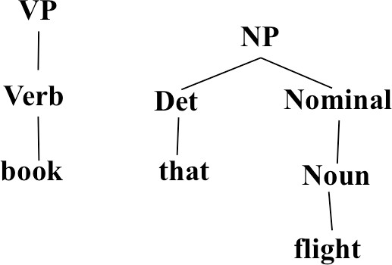
Bottom-Up Parsing
Syntax
Week 5: Lecture 2
48 / 60

Slide 64
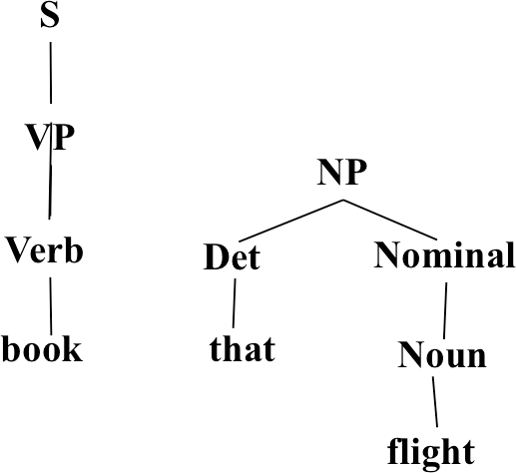
Bottom-Up Parsing
Syntax
Week 5: Lecture 2
49 / 60

Slide 65
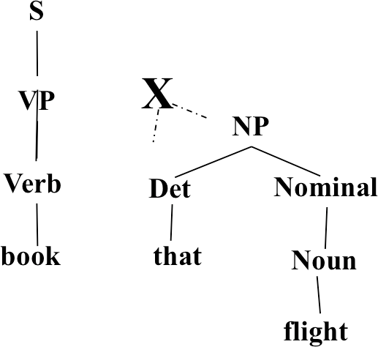
Bottom-Up Parsing
Pawan Goyal (IIT Kharagpur)
Syntax
Week 5: Lecture 2
50 / 60

Slide 66
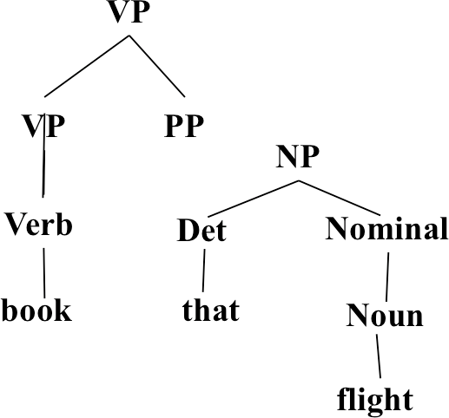
Bottom-Up Parsing
Syntax
Week 5: Lecture 2
51 / 60

Slide 67
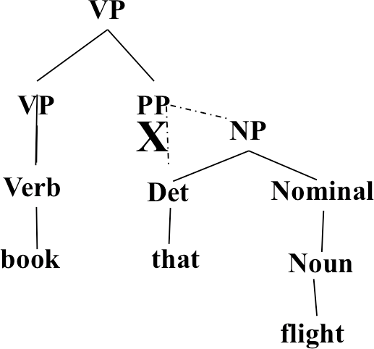
Bottom-Up Parsing
Syntax
Week 5: Lecture 2
52 / 60

Slide 68
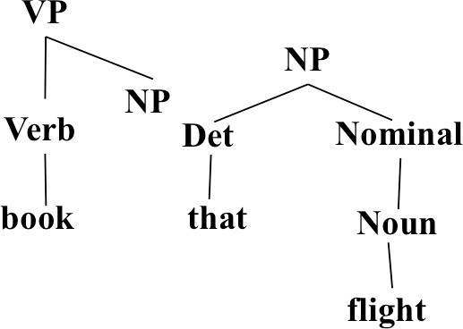
Bottom-Up Parsing
Syntax
Week 5: Lecture 2
53 / 60

Slide 69
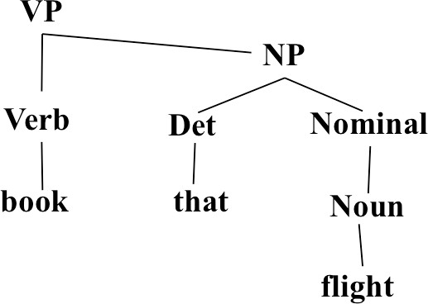
Bottom-Up Parsing
Syntax
Week 5: Lecture 2
54 / 60

Slide 70
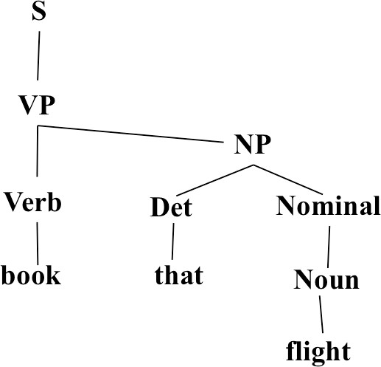
Bottom-Up Parsing
Syntax
Week 5: Lecture 2
55 / 60

Slide 71
Top-Down vs. Bottom-Up
Top down never explores options that will not lead to a full parse, but can explore many options that never connect to the actual sentence.
Bottom up never explores options that do not connect to the actual sentence but can explore options that can never lead to a full parse.
Relative amounts of wasted search depend on how much the grammar branches in each direction.
Syntax
Week 5: Lecture 2
56 / 60

Slide 72
Dynamic Programming Parsing
To avoid extensive repeated work, must cache intermediate results, i.e. completed phrases.
Caching (memoizing) critical to obtaining a polynomial time parsing (recognition) algorithm for CFGs.
Dynamic programming algorithms based on both top-down and bottom-up search can achieve O(n³) recognition time where n is the length of the input string.
Syntax
Week 5: Lecture 2
57 / 60

Slide 73
Dynamic Programming Parsing Methods
CKY (Cocke-Kasami-Younger) algorithm: bottom-up, requires normalizing the grammar
Earley Parser - top-down, does not require normalizing grammar, more complex
More generally, chart parsers retain completed phrases in a chart and can combine top-down and bottom-up searches.
Syntax
Week 5: Lecture 2
58 / 60

Slide 74
CKY Algorithm
Grammar must be converted to Chomsky normal form (CNF) in which all productions must have
Either, exactly two non-terminals on the RHS
Or, 1 terminal symbol on the RHS
Parse bottom-up storing phrases formed from all substrings in a triangular table (chart)
Pawan Goyal (IIT Kharagpur)
Syntax
Week 5: Lecture 2
59 / 60

Slide 75
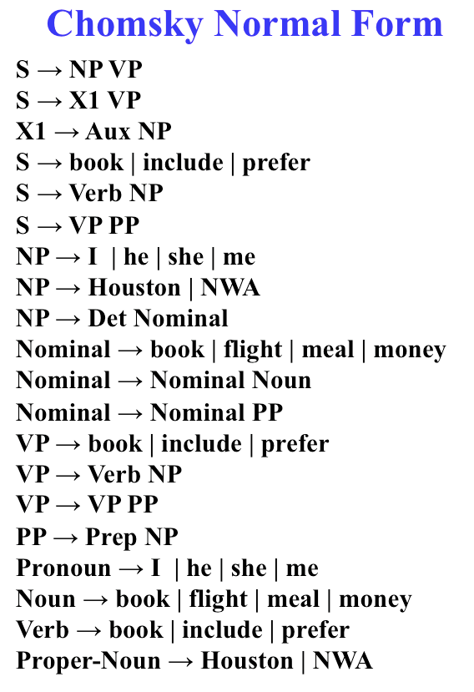
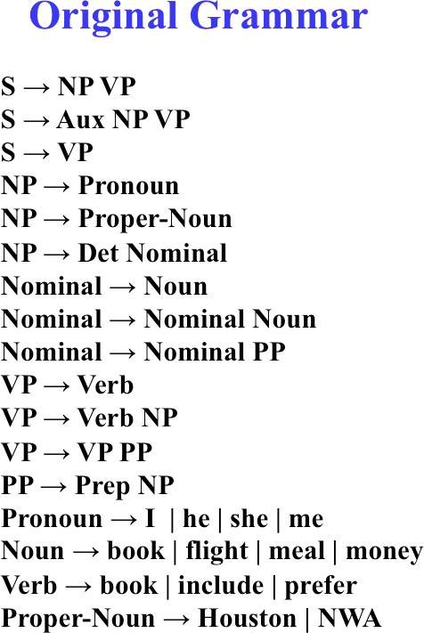
Converting to CNF
Syntax
Week 5: Lecture 2
60 / 60

Slide 76
Syntax -CKY, PCFGs
Syntax
Week 5: Lecture 3
1 / 14

Slide 77
CKY Algorithm
Let n be the number of words in the input. Think about n + 1 lines separating them, numbered 0 to n.
x_{ij} will denote the words between line i and j
We build a table so that x_{ij} contains all the possible non-terminal spanning for words between line i and j.
We build the Table bottom-up.
Home Exercise
Use CKY algorithm to find the parse tree for “Book the flight through Houston” using the CNF form shown in the previous slide.
Syntax
Week 5: Lecture 3
2 / 14

Slide 78

CKY for CFG
Syntax
Week 5: Lecture 3
3 / 14

Slide 79

CKY for CFG
Syntax
Week 5: Lecture 3
4 / 14

Slide 80

What about Ambiguities?
Syntax
Week 5: Lecture 3
5 / 14

Slide 81
Probabilistic Context-free grammars (PCFGs)
PCFG: G = (T, N, S, R, P)
T: set of terminals
N: set of non-terminals
For NLP, we distinguish out a set P ⊂ N of pre-terminals, which always rewrite as terminals
S : start symbol
R: Rules/productions of the form X → γ, X ∈ N and γ ∈ (T ∪ N)∗
Week 5: Lecture 3
6 / 14

Slide 82
Probabilistic Context-free grammars (PCFGs)
PCFG: G = (T, N, S, R, P)
T: set of terminals
N: set of non-terminals
For NLP, we distinguish out a set P ⊂ N of pre-terminals, which always rewrite as terminals
S : start symbol
R: Rules/productions of the form X → γ, X ∈ N and γ ∈ (T ∪ N)∗ P(R) gives the probability of each rule.
∀X ∈ N, . P(X → γ) = 1
X→γ∈R
Syntax
Week 5: Lecture 3
6 / 14

Slide 83

A Simple PCFG (in CNF)
Syntax
Week 5: Lecture 3
7 / 14

Slide 84

Example Trees
Pawan Goyal (IIT Kharagpur)
Syntax
Week 5: Lecture 3
8 / 14

Slide 85

Example Trees
Pawan Goyal (IIT Kharagpur)
Syntax
Week 5: Lecture 3
9 / 14

Slide 86
Probability of trees and strings
P(t): The probability of tree is the product of the probabilities of the rules used to generate it
P(w_{1n}): The probability of the string is the sum of the probabilities of the trees which have that string as their yield
Pawan Goyal (IIT Kharagpur)
Syntax
Week 5: Lecture 3
10 / 14

Slide 87

Tree and String probabilities
Syntax
Week 5: Lecture 3
11 / 14

Slide 88


“Book the dinner flight”
Syntax
Week 5: Lecture 3
12 / 14

Slide 89
“Book the dinner flight”
Probabilities
Parse tree 1: .05 × .20 × .30 × .20 × .60 × .20 × .75 × .10 × .30 = 1.62 × 10⁻⁶
Parse tree 2: .05 × .05 × .30 × .20 × .60 × .75 × .10 × .15 × .75 × .30 =
2.28 × 10⁻⁷
Syntax
Week 5: Lecture 3
12 / 14

Slide 90
Features of PCFGs
As the number of possible trees for a given input grows, a PCFG gives some idea of the plausibility of a particular parse
But the probability estimates are based purely on structural factors, and do not factor in lexical co-occurrence. Thus, PCFG does not give a very good idea of the plausibility of the sentence.
Real text tends to have grammatical mistakes. PCFG avoids this problem by ruling out nothing, but by giving implausible sentences a low probability
In practice, a PCFG is a worse language model for English than an n-gram model
All else being equal, the probability of a smaller tree is greater than a larger tree
Syntax
Week 5: Lecture 3
13 / 14

Slide 91
Important Questions?
Let W_{1m} be a sentence, G a grammar, t a parse tree What is the most likely parse of sentence?
argmax_{t}P(t|w_{1m}, G)
What is the probability of a sentence?
P(w_{1m}|G)
How to learn the rule probabilities in the grammar G?
Syntax
Week 5: Lecture 3
14 / 14

Slide 92
PCFGs - Inside-outside probabilities
Syntax
Week 5: Lecture 4
1 / 14

Slide 93

How to find the most likely parse?: CKY for PCFG
Syntax
Week 5: Lecture 4
2 / 14

Slide 94

CKY for PCFG
Syntax
Week 5: Lecture 4
3 / 14

Slide 95
Probability of a String
P(w_{1m}|G)
In general, simply summing the probabilities of all possible parse trees is not an efficient way to calculate the string probability
We use inside algorithm, a dynamic programming algorithm based on inside probabilities.
Syntax
Week 5: Lecture 4
4 / 14

Slide 96

Inside and Outside Probabilities
Syntax
Week 5: Lecture 4
5 / 14

Slide 97
Inside and Outside Probabilities
Outside: α_{j}(p, q) = P(w_{1(p−1)}, N^{j}_{pq}, w_{(q+1)m}|G)
Inside: β_{j}(p, q) = P(w_{pq}|N^{j}_{pq}, G)
Syntax
Week 5: Lecture 4
5 / 14

Slide 98

Inside-outside probabilities
Syntax
Week 5: Lecture 4
6 / 14

Slide 99

Inside-outside probabilities
Syntax
Week 5: Lecture 4
7 / 14

Slide 100
Inside Probabilities: Base Step
β_{j}(p, q) = P(w_{pq}|N^{j}_{pq}, G)
Base case
β_{j}(k, k) = P(w_{kk}|N^{j}_{kk}, G)
= P(N^{j} → w_{k}|G)
Base case for pre-terminals only
E.g., suppose N^{j} = NN is being considered and NN → building is one of the rules with probability 0.5
β_{NN} (5, 5) = P(building|NN_{5,5}, G) = P(NN_{5,5} → building|G)
Syntax
Week 5: Lecture 4
8 / 14

Slide 101

Inside Probabilities: Induction Step
Assuming Chomsky Normal Form, the first rule must be of the form N^{j} → N^{r} N^{s}
q−1
..
β (p, q) = P
j r s
j
(N → N N )β (p
, d)β (d +1, q)
r
s
r,s d=p
Consider different splits of the words - indicated by d
E.g., the huge building
Consider different non-terminals to be used in the rule: E.g., NP → DT NN, NP → DT NNS
Syntax
Week 5: Lecture 4
9 / 14

Slide 102

Calculation of inside probabilities
Syntax
Week 5: Lecture 4
10 / 14

Slide 103

Calculation of inside probabilities
Syntax
Week 5: Lecture 4
11 / 14

Slide 104


Outside Probabilities
Compute top-down (after inside probabilities)
Base Case
α₁(1, m) = 1
α_{j}(1, m) = 0, j Ç 1
Induction
Syntax
Week 5: Lecture 4
12 / 14

Slide 105
Outside Probabilities: Induction
. .
m
α_{j}(p, q) =
f j g
α (p, e)P(N → N N )β (q + 1
, e)
f
g
f ,g e=q+1
..
p−1
+
f g j
α (e, q)P(N → N N )β (e
, p − 1)
f
g
f ,g e=1
Pawan Goyal (IIT Kharagpur)
Syntax
Week 5: Lecture 4
13 / 14

Slide 106

Product of inside-outside probabilities
α_{j}(p, q)β_{j}(p, q) = P(w_{1(p−1)}, N^{j}_{pq}, w_{(q+1)m}|G)P(w_{pq}|N^{j}_{pq}, G) = P(w_{1m}, N^{j}_{pq}|G)
The probability of the sentence and that there is some consistent spanning from word p to q is given by:
P(w_{1m}, N_{pq}|G) = . α_{j}(p, q)β_{j}(p, q) = P(N₁ → w_{1m}, N_{pq} → w_{pq}|G)
Syntax
Week 5: Lecture 4
14 / 14

Slide 107
Inside-outside probabilities
Syntax
Week 5: Lecture 5
1 / 11

Slide 108
How to get the rule probabilities
Parsed Training Data
You can count!
C(N^{j} → δ)
_{P}ˆ
j
(N → δ) = .
j
γ
C(N → γ)
But what if the training data is not available?
i.e. gold standard parse is not known.
Underlying CFG is known and we are given a set of sentences For each sentence, we can find out all the possible parses
Maximize the likelihood of the sentences in the data under the PCFG constraints
Syntax
Week 5: Lecture 5
2 / 11

Slide 109

Example data
Syntax
Week 5: Lecture 5
3 / 11

Slide 110


Example data
Rules of the form A → w
Rules of the form A → BC
Syntax
Week 5: Lecture 5
3 / 11

Slide 111


Example data
Is any other parse possible for She eats pizza without anchovies syntactically? Consider She eats pizza without hesitation
New Context-free rules:
Syntax
Week 5: Lecture 5
4 / 11

Slide 112


Estimating the model parameters
We need to find probabilities such as
φ(S → N V)
φ(N → pizza)
Requirements
For each non-terminal A, the derivation probabilities sum up to 1
. φ(A → α) = 1
α
For the example grammar:
Pawan Goyal (IIT Kharagpur)
Syntax
Week 5: Lecture 5
5 / 11

Slide 113


Likelihood computation
Syntax
Week 5: Lecture 5
6 / 11

Slide 114

Likelihood computation
Likelihood of the corpus
.
Probability of a sentence W : P (W) = P (W, T)
φ φ
T
If the training data comprises of sentences W₁, W₂,..., W_{N} , then the likelihood is
L(φ) = P_{φ}(W₁)P_{φ}(W₂)··· P_{φ}(W_{N} )
Syntax
Week 5: Lecture 5
7 / 11

Slide 115
Likelihood maximization
Approach
Starting at some initial parameters φ, re-estimate to obtain new parameters φ^{j}
for which L(φ^{j}) ≥ L(φ). Repeat until convergence
Syntax
Week 5: Lecture 5
8 / 11

Slide 116


Parameter Estimation
Given some rule probabilities φ and training corpus W₁, W₂ . . . W_{n}, the new parameters are obtained as:
What is count(.)?
c_{φ}(A → α, W_{i}) is the expected number of times (A → α) is used in generating the sentence W_{i}, when the rule probabilities are given by φ
Syntax
Week 5: Lecture 5
9 / 11

Slide 117
Computing Expected counts
Inside probabilities
The nonterminal A derives the string of words w_{i}, . . . w_{j} in the sentence :
β_{ij}(A) = P_{φ}(A⇒∗w_{i} . . . w_{j})
Outside probabilities
Beginning with the start symbol S we can derive the string
w₁ . . . w_{i−1}Aw_{j+1} . . . w_{n} : α_{ij}(A) = P_{φ}(S⇒∗w₁ . . . w_{i−1}Aw_{j+1} . . . w_{n})
Expected count
φ(A → BC)
P_{φ}(W)
.
c (A → BC, W) =
α (A)β (B)β (C)
φ
ik ij j+1,k
1≤i≤j≤k≤n
φ(A → w)
.
c_{φ}(A → w, W) =
α (A)
P_{φ}(W)
ii
1≤i≤n
Pawan Goyal (IIT Kharagpur)
Syntax
Week 5: Lecture 5
10 / 11

Slide 118
And how to compute inside-outside probabilities
Inductively, as discussed earlier
β_{ii}(A) = φ(A → w_{i}) α_{1n}(S) = 1
Pawan Goyal (IIT Kharagpur)
Syntax
Week 5: Lecture 5
11 / 11

Slide 119
Dependency Grammars and Parsing - Introduction
Dependency Grammars and Parsing - Introduction
Week 6, Lecture 1
119 / 11

Slide 120

Phrase Structure Representation
Dependency Grammars and Parsing - Introduction
Week 6, Lecture 1
120 / 11

Slide 121

Dependency Structure Representation
Dependency Grammars and Parsing - Introduction
Week 6, Lecture 1
121 / 11

Slide 122

Dependency Structure
Connects the words in a sentence by putting arrows between the words.
Arrows show relations between the words and are typed by some grammatical relations.
Arrows connect a head (governor, superior, regent) with a dependent (modifier, inferior, subordinate).
Usually dependencies form a tree.
Dependency Grammars and Parsing - Introduction
Week 6, Lecture 1
122 / 11

Slide 123
Criteria for Heads and Dependents
Criteria for a syntactic relation between a head H and a dependent D in a construction C
H determines the syntactic category of C; H can replace C.
D specifies H.
H is obligatory; D may be optional.
H selects D and determines whether D is obligatory.
The form of D depends on H (agreement or government). The linear position of D is specified with reference to H.
Dependency Grammars and Parsing - Introduction
Week 6, Lecture 1
123 / 11

Slide 124

Some Clear Cases
Dependency Grammars and Parsing - Introduction
Week 6, Lecture 1
124 / 11

Slide 125
Comparison
Phrase structures explicitly represent
Phrases (nonterminal nodes)
Structural categories (nonterminal labels)
Dependency structures explicitly represent Head-dependent relations (directed arcs) Functional categories (arc labels)
Week 6, Lecture 1
7 / 11

Slide 126
Dependency Graphs
A dependency structure can be defined as a directed graph G, consisting of
a set V of nodes,
a set A of arcs (edges),
Labeled graphs:
Nodes in V are labeled with word forms (and annotation).
Arcs in A are labeled with dependency types.
Notational convention:
Arc (w_{i}, d, w_{j}) links head w_{i} to dependent w_{j} with label d
d
w_{i} −→ w_{j} ⇔ (w_{i}, d, w_{j}) ∈ A
i → j ≡ (i, j) ∈ A
i→∗j ≡ i = j ∨ ∃k : i → k, k→∗j
Dependency Grammars and Parsing - Introduction
Week 6, Lecture 1
8 / 11

Slide 127
Formal conditions on Dependency Graphs
G is connected:
For every node i there is a node j such that i → j or j → i.
G is acyclic:
if i → j then not j→∗i.
G obeys the single head constraint:
if i → j then not k → j, for any k Ç i.
G is projective:
if i → j then j→∗k, for any k such that both j and k lie on the same side of i.
Dependency Grammars and Parsing - Introduction
Week 6, Lecture 1
9 / 11

Slide 128

Formal conditions on Dependency Graphs
G is connected:
For every node i there is a node j such that i → j or j → i.
G is acyclic:
if i → j then not j→∗i.
G obeys the single head constraint:
if i → j then not k → j, for any k Ç i.
G is projective:
if i → j then j→∗k, for any k such that both j and k lie on the same side of i.
Dependency Grammars and Parsing - Introduction
Week 6, Lecture 1
9 / 11

Slide 129

Formal Conditions: Basic Intuitions
Connectedness, Acyclicity and Single-Head Connectedness: Syntactic structure is complete. Acyclicity: Syntactic structure is hierarchical.
Single-Head: Every word has at most one syntactic head.
Projectivity: No crossing of dependencies.
Dependency Grammars and Parsing - Introduction
Week 6, Lecture 1

Slide 130
Dependency Parsing
Dependency Parsing
Input: Sentence x = w₁,..., w_{n}
Output: Dependency graph G
Parsing Methods
Deterministic Parsing
Maximum Spanning Tree Based Constraint Propagation Based
Dependency Grammars and Parsing - Introduction
Week 6, Lecture 1

Slide 131
Transition Based Parsing: Formulation
Transition Based Parsing: Formulation
Week 6, Lecture 2
1 / 15

Slide 132
Deterministic Parsing
Basic idea
Derive a single syntactic representation (dependency graph) through a deterministic sequence of elementary parsing actions
Configurations
A parser configuration is a triple c = (S, B, A), where S : a stack [. . . , w_{i}]_{S} of partially processed words, B : a buffer [w_{j}, . . .]_{B} of remaining input words,
A : a set of labeled arcs (w_{i}, d, w_{j}).
Transition Based Parsing: Formulation
Week 6, Lecture 2
2 / 15

Slide 133
Transition System
A transition system for dependency parsing is a quadruple S = (C, T, c_{s}, C_{t}), where
C is a set of configurations,
T is a set of transitions, such that t : C → C, c_{s} is an initialization function
C_{t} ⊆ C is a set of terminal configurations.
A transition sequence for a sentence x is a set of configurations
C_{0,m} = (c_{o}, c₁, . . . , c_{m}) such that
c_{o} = c_{s}(x), c_{m} ∈ C_{t}, c_{i} = t(c_{i−1}) for some t ∈ T
Initialization: ([]_{S}, [w₁,..., w_{n}]_{B},{})
Termination: (S, []_{B}, A)
Transition Based Parsing: Formulation
Week 6, Lecture 2
3 / 15

Slide 134

Transitions for Arc-Eager Parsing
Transition Based Parsing: Formulation
Week 6, Lecture 2

Slide 135

Example
Transition Based Parsing: Formulation
Week 6, Lecture 2

Slide 136

Example
Transition Based Parsing: Formulation
Week 6, Lecture 2

Slide 137

Example
Transition Based Parsing: Formulation
Week 6, Lecture 2

Slide 138

Example
Transition Based Parsing: Formulation
Week 6, Lecture 2

Slide 139

Example
Transition Based Parsing: Formulation
Week 6, Lecture 2

Slide 140

Example
Transition Based Parsing: Formulation
Week 6, Lecture 2

Slide 141

Example
Transition Based Parsing: Formulation
Week 6, Lecture 2

Slide 142

Example
Transition Based Parsing: Formulation
Week 6, Lecture 2

Slide 143

Example
Transition Based Parsing: Formulation
Week 6, Lecture 2

Slide 144

Example
Transition Based Parsing: Formulation
Week 6, Lecture 2

Slide 145

Example
Transition Based Parsing: Formulation
Week 6, Lecture 2

Slide 146
Transition Based Parsing: Learning
Transition Based Parsing: Learning
Week 6, Lecture 3
1 / 8

Slide 147
Classifier-Based Parsing
Data-driven deterministic parsing:
Deterministic parsing requires an oracle.
An oracle can be approximated by a classifier. A classifier can be trained using treebank data.
Learning Problem
Approximate a function from configurations, represented by feature vectors to transitions, given a training set of gold standard transition sequences.
Three issues
How to represent configurations by feature vectors?
How to derive training data from treebanks? How to learn classifiers?
Transition Based Parsing: Learning
Week 6, Lecture 3
2 / 8

Slide 148
Feature Models
A feature representation f (c) of a configuration c is a vector of simple features
f_{i}(c).
Typical Features
Nodes:
Target nodes (top of S, head of B)
Linear context (neighbors in S and B)
Structural context (parents, children, siblings in G)
Attributes:
Word form (and lemma)
Part-of-speech (and morpho-syntactic features)
Dependency type (if labeled)
Distance (between target tokens)
Transition Based Parsing: Learning
Week 6, Lecture 3
3 / 8

Slide 149
Deterministic Parsing
To guide the parser, a linear classifier can be used:
t∗ = argmax w.f (c, t)
t
Weight vector w learned from treebank data.
Using classifier at run-time
PARSE(w₁, . . . , w_{n})
1 c ← ([]_{S}, [w₁,..., w_{n}]_{B},{})
while B_{c} Ç []
t∗ ← argmax_{t} w.f (c, t)
4 c ← t∗(c)
5 return T = ({w₁,..., w_{n}}, A_{c})
Transition Based Parsing: Learning
Week 6, Lecture 3
4 / 8

Slide 150
Training data
Training instances have the form (f (c), t), where
f (c) is a feature representation of a configuration c,
t is the correct transition out of c (i.e., o(c) = t).
Given a dependency treebank, we can sample the oracle function o as follows:
For each sentence x with gold standard dependency graph G_{x}, construct a transition sequence C_{0,m} = (c₀, c₁, . . . , c_{m}) such that
c₀ = c_{s}(x), G_{cm} = G_{x}
For each configuration c_{i}(i < m), we construct a training instance (f (c_{i}), t_{i}), where t_{i}(c_{i}) = c_{i+1}.
Transition Based Parsing: Learning
Week 6, Lecture 3
5 / 8

Slide 151
Standard Oracle for Arc-Eager Parsing
o(c, T) =
Left-Arc if top(S_{c}) ← first(B_{c}) in T
Right-Arc if top(S_{c}) → first(B_{c}) in T Reduce if ∃w < top(S_{c}) : w ↔ first(B_{c}) in T Shift otherwise
Transition Based Parsing: Learning
Week 6, Lecture 3
6 / 8

Slide 152
Online Learning with an Oracle
LEARN({T₁,..., T_{N} })
1 w ← 0.0
for i in 1..K
for j in 1..N
4 c ← ([]_{S}, [w₁,..., w_{nj} ]_{B}, {})
5
6
7
8
9
10
11 return w
while B_{c} Ç []
t∗ ← argmax_{t} w.f (c, t)
t_{o} ← o(c, T_{i})
if t∗ Ç t_{o}
w ← w + f (c, t_{o}) − f (c, t∗)
c ← t_{o}(c)
Oracle o(c, T_{i}) returns the optimal transition of c and T_{i}
Transition Based Parsing: Learning
Week 6, Lecture 3
7 / 8

Slide 153
Example
Consider the sentence, ‘John saw Mary’.
Draw a dependency graph for this sentence.
Assume that you are learning a classifier for the data-driven deterministic parsing and the above sentence is a gold-standard parse in your training data. You are also given that John and Mary are ‘Nouns’, while the POS tag of saw is ‘Verb’. Assume that your features correspond to the following conditions:
The stack is empty
Top of stack is Noun and Top of buffer is Verb
Top of stack is Verb and Top of buffer is Noun
Initialize the weights of all your features to 5.0, except that in all of the above cases, you give a weight of 5.5 to Left-Arc. Define your feature vector and the initial weight vector.
Use this gold standard parse during online learning and report the weights after completing one full iteration of Arc-Eager parsing over this sentence.
Transition Based Parsing: Learning
Week 6, Lecture 3
8 / 8

Slide 154
MST-based Dependency Parsing
MST-based Dependency Parsing
Week 6, Lecture 4
1 / 16

Slide 155


Maximum Spanning Tree Based
Basic Idea
Starting from all possible connections, find the maximum spanning tree.
MST-based Dependency Parsing
Week 6, Lecture 4
2 / 16

Slide 156

Some Graph Theory Reminders
A graph G = (V, A) is a set of vertices V and arcs (i, j) ∈ A where i, j ∈ V. Undirected graphs: (i, j) ∈ A ⇔ (j, i) ∈ A
Directed graphs (digraphs) : (i, j) ∈ A a (j, i) ∈ A
Week 6, Lecture 4
3 / 16

Slide 157

Multi-Digraphs
A multi-digraph is a digraph where multiple arcs between vertices are possible
(i, j, k) ∈ A represents the k^{th} arc from vertex i to vertex j.
MST-based Dependency Parsing
Week 6, Lecture 4
4 / 16

Slide 158

Directed Spanning Trees
A directed spanning tree of a (multi-)digraph G = (V, A) is a subgraph
G^{j} = (V^{j}, A^{j}) such that:
V^{j} = V
A^{j} ⊆ A, and |A^{j}| = |V^{j}| − 1
G^{j} is a tree (acyclic)
A spanning tree of the following (multi-)digraphs
MST-based Dependency Parsing
Week 6, Lecture 4
5 / 16

Slide 159
Weighted Directed Spanning Trees
Assume we have a weight function for each arc in a multi-digraph
G = (V, A).
Define w_{ij}^{k} ≥ 0 to be the weight of (i, j, k) ∈ A for a multi-digraph Define the weight of directed spanning tree G^{j} of graph G as
.
w(G^{j}) =
Σ wij^{k}
(i,j,k)∈G^{j}
MST-based Dependency Parsing
Week 6, Lecture 4
6 / 16

Slide 160

Maximum Spanning Trees (MST)
Let T(G) be the set of all spanning trees for graph G
MST-based Dependency Parsing
Week 6, Lecture 4
7 / 16

Slide 161
Maximum Spanning Trees (MST)
Let T(G) be the set of all spanning trees for graph G
The MST problem
Find the spanning tree G^{j} of the graph G that has the highest weight
.
G^{j} = argmax w(G^{j}) = argmax
Σ wij^{k}
G^{j}∈T(G)
^{Gj∈T(G)} (i,j,k)∈G^{j}
MST-based Dependency Parsing
Week 6, Lecture 4
7 / 16

Slide 162
Finding MST
Directed Graph
For each sentence x, define the directed graph G_{x} = (V_{x}, E_{x}) given by
V_{x} = {x₀ = root, x₁, . . . , x_{n}}
E_{x} = {(i, j) : i Ç j, (i, j) ∈ [0 : n] × [1 : n]}
G_{x} is a graph with
the sentence words and the dummy root symbol as vertices and a directed edge between every pair of distinct words and
a directed edge from the root symbol to every word
MST-based Dependency Parsing
Week 6, Lecture 4
8 / 16

Slide 163
Chu-Liu-Edmonds Algorithm
Chu-Liu-Edmonds Algorithm
Each vertex in the graph greedily selects the incoming edge with the highest weight.
If a tree results, it must be a maximum spanning tree. If not, there must be a cycle.
Identify the cycle and contract it into a single vertex.
Recalculate edge weights going into and out of the cycle.
MST-based Dependency Parsing
Week 6, Lecture 4

Slide 164
Chu-Liu-Edmonds Algorithm
x = John saw Mary
Build the directed graph
MST-based Dependency Parsing
Week 6, Lecture 4

Slide 165

Chu-Liu-Edmonds Algorithm
Find the highest scoring incoming arc for each vertex
If this is a tree, then we have found MST.
MST-based Dependency Parsing
Week 6, Lecture 4

Slide 166

Chu-Liu-Edmonds Algorithm
If not a tree, identify cycle and contract Recalculate arc weights into and out-of cycle
MST-based Dependency Parsing
Week 6, Lecture 4

Slide 167

Chu-Liu-Edmonds Algorithm
Outgoing arc weights
Equal to the max of outgoing arc over all vertices in cycle e.g., John → Mary is 3 and saw → Mary is 30.
MST-based Dependency Parsing
Week 6, Lecture 4

Slide 168
Chu-Liu-Edmonds Algorithm
Incoming arc weights
Equal to the weight of best spanning tree that includes head of incoming arc and all nodes in cycle
root → saw → John is 40 root → John → saw is 29
MST-based Dependency Parsing
Week 6, Lecture 4

Slide 169

Chu-Liu-Edmonds Algorithm
Calling the algorithm again on the contracted graph:
This is a tree and the MST for the contracted graph
Go back up the recursive call and reconstruct final graph
MST-based Dependency Parsing
Week 6, Lecture 4

Slide 170
Chu-Liu-Edmonds Algorithm
The edge from w_{js} to Mary was from saw
The edge from root to w_{js} represented a tree from root to saw to John.
MST-based Dependency Parsing
Week 6, Lecture 4

Slide 171
MST-based Dependency Parsing: Learning
MST-based Dependency Parsing: Learning
Week 6, Lecture 5
1 / 10

Slide 172
Arc weights as linear classifiers
w_{ij}^{k} = w.f (i, j, k)
Arc weights are a linear combination of features of the arc f (i, j, k) and a corresponding weight vector w
What arc features?
MST-based Dependency Parsing: Learning
Week 6, Lecture 5
2 / 10

Slide 173

Arc Features f (i, j, k)
Features
Identities of the words w_{i} and w_{j} for a label l_{k}
head = saw & dependent=with
MST-based Dependency Parsing: Learning
Week 6, Lecture 5
3 / 10

Slide 174
Arc Features f (i, j, k)
Features
Part-of-speech tags of the words w_{i} and w_{j} for a label l_{k}
head-pos = Verb & dependent-pos=Preposition
MST-based Dependency Parsing: Learning
Week 6, Lecture 5
4 / 10

Slide 175
Arc Features f (i, j, k)
Features
Part-of-speech of words surrounding and between w_{i} and w_{j}
inbetween-pos = Noun inbetween-pos = Adverb dependent-pos-right = Pronoun head-pos-left=Noun
MST-based Dependency Parsing: Learning
Week 6, Lecture 5
5 / 10

Slide 176
Arc Features f (i, j, k)
Features
Number of words between w_{i} and w_{j}, and their orientation
arc-distance = 3 arc-direction = right
Week 6, Lecture 5
6 / 10

Slide 177
Arc Features f (i, j, k)
Features
Combinations
head-pos=Verb & dependent-pos=Preposition & arc-label=PP head-pos=Verb & dependent=with & arc-distance=3
No limit : any feature over arc (i, j, k) or input x
MST-based Dependency Parsing: Learning
Week 6, Lecture 5
7 / 10

Slide 178
Learning the parameters
Re-write the inference problem
.
G = argmax
wij^{k}
^{G∈T(Gx )} (i,j,k)∈G
= argmax w · . f (i, j, k)
G∈T(Gx )
(i,j,k)∈G
= argmax w · f (G)
G∈T(Gx )
Which can be plugged into learning algorithms
Week 6, Lecture 5
8 / 10

Slide 179
Inference-based Learning
Training data: T = {
(x , G )}
|T|
t=1
t t
1. w⁽⁰⁾ = 0; i = 0
2. for n : 1..N
3. for t : 1..|T|
4.
5.
6.
7. i = i + 1
8. return w^{i}
Let G^{j} = argmax_{G}j w^{(i)}.f (G^{j})
if G^{j} Ç G_{t}
w^{(i+1)} = w^{(i)} + f (G_{t}) − f (G^{j})
MST-based Dependency Parsing: Learning
Week 6, Lecture 5

Slide 180
Example
Suppose you are training MST Parser for dependency and the sentence, “John saw Mary” occurs in the training set. Also, for simplicity, assume that there is only one dependency relation, “rel”. Thus, for every arc from word w_{i} to w_{j}, your features may be simplified to depend only on words w_{i} and w_{j} and not on the relation label.
Below is the set of features
f₁: pos(w_{i}) = Noun and pos(w_{j}) = Noun f₂: pos(w_{i}) = Verb and pos(w_{j}) = Noun f₃: w_{i} = Root and pos(w_{j}) = Verb
f₄: w_{i} = Root and pos(w_{j}) = Noun
f₅: w_{i} = Root and w_{j} occurs at the end of sentence
f₆: w_{i} occurs before w_{j} in the sentence
f₇: pos(w_{i}) = Noun and pos(w_{j}) = Verb
The feature weights before the start of the iteration are: {3, 20, 15, 12, 1, 10, 20}. Determine the weights after an iteration over this example.
MST-based Dependency Parsing: Learning
Week 6, Lecture 5

